Slide 1
Exam Instructions
Date: 10/29/2018 from 8:00 pm to 9:50 pm.
Maximum credits/points/percentage for this midterm: 100
The percentages for each question are indicated in square brackets [ ].
No books (or any other material) are allowed.
Write down your name, student ID and USC email address on both test and answer booklets.
Your exam will be scanned and uploaded online.
Write within the spaces provided for your answers in the test answer booklet.
Do NOT write on the 2D barcode.
The back of the exam pages will NOT be graded. You may use it for scratch.
No questions during the exam. If something is unclear to you, write that in your exam.
Be brief: a few words are often enough if they are precise and use the correct vocabulary studied in class.
When finished before 9:40pm, raise completed exam sheets until approached by proctor.
At 9:50pm, put down your pen/pencil. Stay seated and pass your exam to the nearest aisle or receive 10% exam penalty.
Adhere to the Academic Integrity code.

Slide 2
CSCI561 Fall 2018 Week 10 Discussion
Prof Sheila Tejada
Prof Wei-min shen
Prof Ning wang
cs561-l@mymaillists.usc.edu
cs561-l@mymaillists.usc.edu

Slide 3
Material covered by midterm
Covers everything studied in class up to and including Planning (chap. 7-10,12) , October 29, 8pm
Lectures vs Disussion vs book: what to know?
if a topic is studied in lecture/discussion and is also in the book: need to know both.
if a topic is studied in lecture/discussion only and is not in the book: know what was studied in class.
if a topic is in the book but was not covered at all in class: no need to know.
Opening the exam before you are given the go signal will result in automatic filing of a case with the office of student judicial affairs.
Cheating during the exam will result in automatic filing of a case with the office of student judicial affairs.
Continuing to write after the stop signal will result in automatic filing of a case with the office of student judicial affairs.

Slide 4

Probabilistic Inference by Enumeration
Can perform probabilistic inference by enumerating over (full) joint probability distribution
Analogous to model checking in propositional logic, but here we are summing probabilities over all action events rather than checking for satisfiability in one or all of the models
Start with the joint probability distribution P(Cavity,Toothache,Catch)
For any proposition φ, sum p for atomic events where true
P(φ) = Σ_{ω:ω╞φ} P(ω)
P(toothache)
= .108 + .012 + .016 + .064 = .2
P(cavity)
= .108 + .012 + .72 +.08 = .2
Catch refers to Dentist’s
instrument catching on tooth
Called marginal probability of toothache
The overall process is called marginalization or summing out: [P(Y) = Σ_{z}P(Y,z)]

Slide 5
Inference of Complex Propositions
Can also infer values of complex propositions in the same manner
Sum over all action events in which proposition is true
P(toothache ∨ cavity)
= .108 + .012 + .016 + .064 + .072 + .008 = .28
P(toothache ∧ cavity)
= .108 + .012 = .12
P(toothache ⇒ cavity)
= .108 +.012 +.072 + .008 + .144 + .576 = .92
P(cavity ⇒ toothache)
= .108 +.012 +.016 + .064 + .144 + .576 = .92

Slide 6
Normalized Inference Procedure
General inference procedure for cond. distributions:
P(X | e) = P(X,e)/P(e) = αP(X,e) = αΣ_{y}P(X,e,y)
X is a single query variable
e is a vector of values of the evidence variables E
y is a vector of values for the remaining unobserved variables Y
P(X,e,y) is a subset of values from the joint probability distribution
Dentistry example
P(Cavity | toothache)
= P(Cavity,toothache)/P(toothache)
= αP(Cavity,toothache)
= α[P(Cavity,toothache,catch)+P(Cavity,toothache,¬catch)]
= (1/.2)[⟨.108,0.016⟩ + ⟨.012,.064⟩] = 5⟨.12,.08⟩ = ⟨.6,.4⟩
Only problem, but a big one, is that this does not scale well
If there are n Boolean variables, space and time are O(2^{n})
Will look shortly at independence as a means of dealing with this

Slide 7
Alarm Example (Cont.)
Only one value needed for X_{i} in each row because, for boolean variables, P(false)=1-P(true)
All factors (possibly infinite) not explicitly mentioned are implicitly incorporated into probabilities
Bird could fly through window pane, power could fail, …
Notes:
Qualification problem

Slide 8
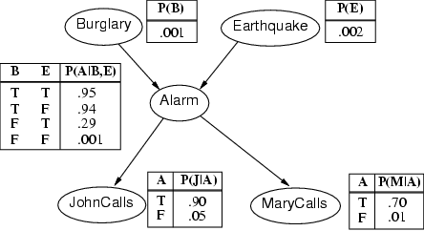
Compactness/Efficiency
A Conditional Probability Table (CPT) for Boolean X_{i} with k Boolean parents has 2^{k} rows for the combinations of parent values
If each of the n variables has no more than k parents, the complete network requires O(n · 2^{k}) numbers
I.e., grows linearly with n vs. O(2^{n}) for the full joint distribution
For burglary net, 1+1+4+2+2=10 numbers (vs. 2⁵-1=31)

Slide 9
Semantics
If correct, the network represents the full joint distribution: P(x₁, … ,x_{n}) = π_{i=1} P(x_{i} | parents(X_{i}))
n

Slide 10
P(x₁, … ,x_{n}) = π_{i=1} P(x_{i} | parents(X_{i}))
E.g., the probability of a complete false alarm (no burglary or earthquake) with two calls is:
P(j, m, a, ¬b, ¬e)
= P(j | a) P(m | a) P(a | ¬b, ¬e) P(¬b) P(¬e)
= .9 x .7 x .001 x .999 x .998 ≈ .000063
n

Slide 11
Probability formulas
Conditional probability: P(a | b) = P(a ∧ b) / P(b)
Product rule: P(a ∧ b) = P(a | b) P(b) = P(b | a) P(a)
⇒ Bayes' rule: P(a | b) = P(b | a) P(a) / P(b)

Slide 12
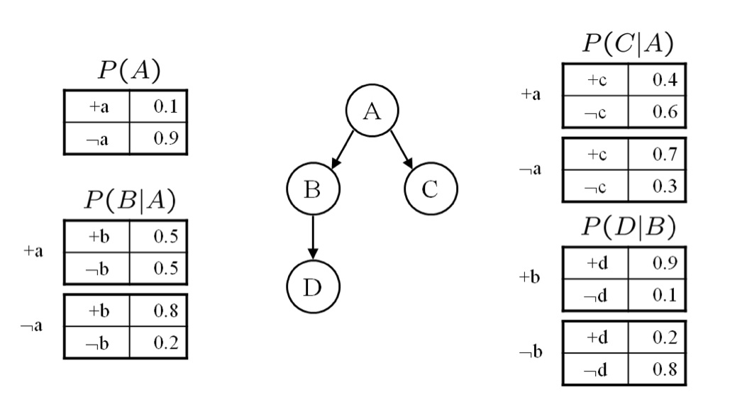
Bayesian Networks
Given this network calculate the following probabilities. Give both the formula and calculations with values. These questions are designed so that they can be answered with a minimum of computation. If you find yourself doing a copious amount of computation for each part, step back and consider whether there is simpler way to deduce the answer.
1. P(a,¬b,c,¬d)
P (a)P (¬b|a)P (c|a)P (¬d|¬b)
= 0.1 × 0.5 × 0.4 × 0.8 = 0.016

Slide 13
Bayesian Networks
2. P(b)
P(b) = ∑_{A={a,¬a}} P(A)P(b|A)
= 0.1 × 0.5 + 0.9 × 0.8 = 0.77
3. P(a|b)
P (a|b) = P (a,b)/ P (b) = P (a)P (b|a) / P (b)
= 0.1×0.5 / .77 = 0.064935

Slide 14
Bayesian Networks
4. P(d|a)
P (d|a) = ∑_{B={b,¬b}} P (d|B)p(B|a)
= 0.9 × 0.5 + 0.2 × 0.5 = 0. 55
5. P(d|a,c)
From the conditional independence properties of the graph, D ⊥ C|{A}. Hence, P(d|a,c) = p(d|a)
= 0.55

Slide 15
Exercise 14.1
We have a bag of three biased coins a, b, and c with probabilities of coming up heads of 20%, 60%, and 80%, respectively. One coin is drawn randomly from the bag (with equal likelihood of drawing each of the three coins), and then the coin is flipped three times to generate the outcomes X₁^{, X}₂^{, and X}₃.
a. Draw the Bayesian network corresponding to this setup and define the necessary CPTs.
b. Calculate which coin was most likely to have been drawn from the bag if the observed flips come out heads twice and tails once.

Slide 16
Exercise 14.1
With the random variable C denoting which coin {a, b, c} we drew, the network has C at the root and X1, X2, and X3 as children.
The CPT for C is:
C
x1
x2
xx33
^{The CPT for X}_{i} given C are the same, and equal to:

Slide 17
Exercise 14.1
The coin most likely to have been drawn from the bag given this sequence is the value of C with greatest posterior probability P(C|2 heads, 1 tails).
P(C|2 heads, 1 tails) = P(2 heads, 1 tails|C)P(C)/P(2 heads, 1 tails)
1/P (2 heads, 1 tails) is independent of C
^{∝ P(2heads,1tails|C)P(C)}
P(C) is independent of the value of C, ^{by hypothesis, equal to 1/3.}
^{∝ P(2 heads, 1 tails|C)}

Slide 18
Exercise 14.1
^{X}₁^{, X}₂^{, and X}₃ are conditionally independent given C, so for example
^{P (X}₁ ^{= tails, X}₂ ^{= heads, X}₃ ^{= heads|C = a)}
^{= P(X}₁ ^{= tails|C = a)P(X}₂ ^{= heads|C = a)P(X}₃ ^{= heads|C = a)}
^{= 0.8×0.2×0.2=0.032}
P (2heads, 1tails|C = a) = 3 × 0.032 = 0.096.
Note that we would get the same probability above for any ordering of 2 heads and 1 tails.
P (2heads, 1tails|C = b) = 0.432
P (2heads, 1tails|C = c) = 0.384
showing that coin b is most likely to have been drawn.
Alternatively, one could directly compute the value of P(C|2 heads, 1 tails).

Slide 19
What you should know
What are the sources for uncertainty?
How can we use probability to reason about uncertainty?
What is a random variable? Atomic events? How are they used for inference?
What is independence? What is conditional independence? Why are they needed for reasoning about uncertainty?
What is Bayes rule? How is this addressing combining evidence for diagnosis?
Bayesian networks provide a natural representation for (causally induced) conditional independence
Topology + CPTs = compact representation of joint distribution

Slide 20
Want more?
Try exercise 13.4,7,8,13,15, 14.2,4,8 in AIMA

